Slide 1
Installation ReadMe for Shapes Pew Peww
Matthew Gattis
John Boling
Randall Harper

Slide 2

Step 1: Dreamspark
If you already have Visual Studio skip to the next step
Visit https://www.dreamspark.com/
Click on the “Students” tab
Log in/create log in for student using your TTU email
Find Visual Studio, we used VS Profession 2012, download and install using recommended settings

Slide 3
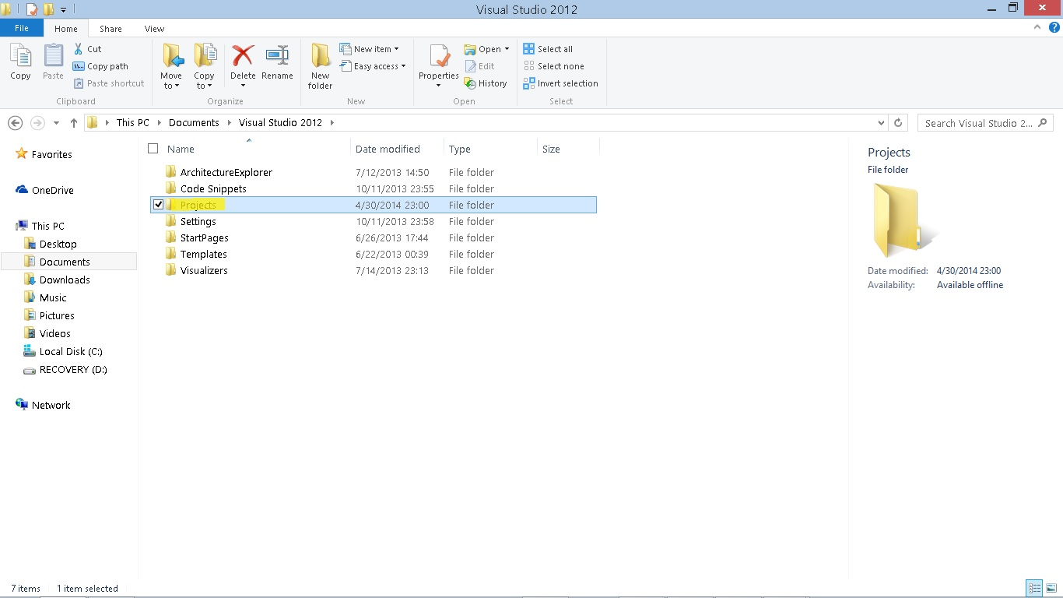
Step 2: Where to save our files
Open “File Explorer”, navigate to your \Documents\Visual Studio 2012\Projects folder
Create a new folder named “Shapes Pew Peww”

Slide 4
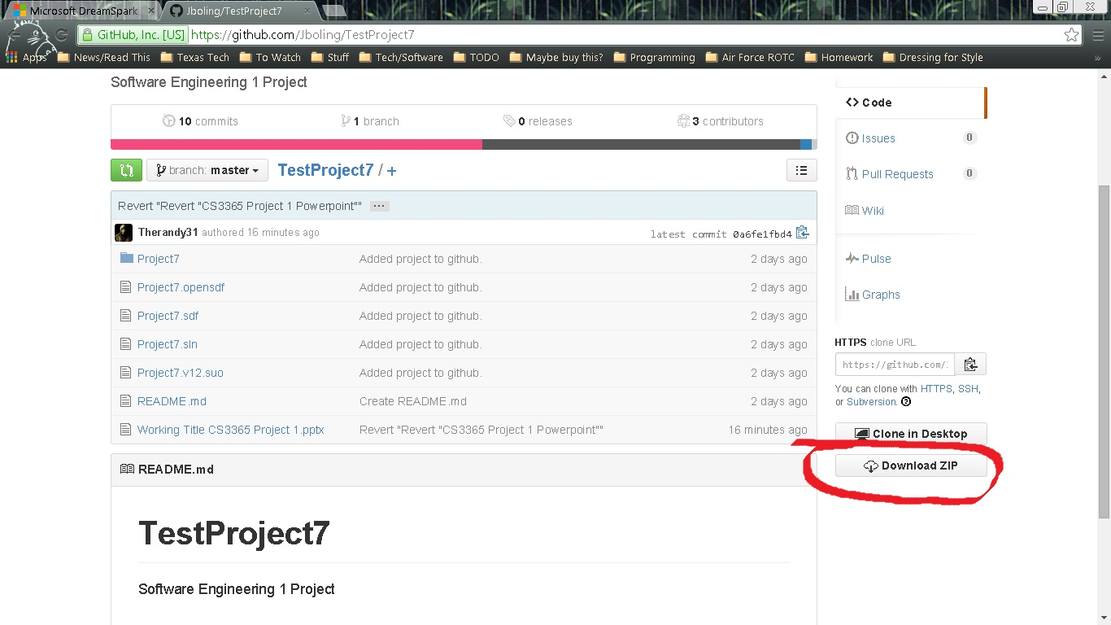
Step 3: Getting our Files
Download our files from https://github.com/Jboling/TestProject7 by clicking the “Download ZIP” button
Save in the \Documents\Visual Studio 2012\Projects\TestProject7 folder, and extract the .zip files in that folder

Slide 5
Step 4: Visual Studio
Open Visual Studio, click “File”, “Open”, “Project/Solution”
Navigate to your “TestProject7” folder and open the TestProject7.sln file
If everything is installed correctly, you should now be able to run the program by hitting “ctrl+f5”
You can also run the game by starting the .exe program

